Slide 1
^{9th} session.
Marketing Plan. 4P's: Price and Promotion

Slide 2
Price

Slide 3

Prices: issues to consider.
Use or Enjoyment value
Life cycle
Competitors price
Response to demand
regulations
Cross elasticity
cost
For decision making process:
  Costs
  Competitors prices
  Price without reference
  Commercial or strategic price
  Strategies to set prices

Slide 4
Prices
Consider:
A) COSTS
The first indicator for prices is the cost for producing and commercializing each product because,
Retail price > cost 1º) Company’s goal: earn money
2º) Dumping (pricing a product below its cost of product is not allowed.)
B) The Prices of Reference in the Market (COMPETITORS PRICES)
Notes:
Aspects concerning setting prices, revise each one while commenting.

Slide 5
Prices.
When considering the price of our competitors as a reference point, we have to differentiate between two distinct situations:
The price is the decisive element of our product, if the product does not have any differentiation possibility, the way for entering to the market is offering a competitive price.
The product is the decisive element, if the product can be differentiated from its competitors for some feature, the product can be superior to the competitors ones in function of the perception of the customers.
Notes:
Aspects concerning setting prices, revise each one while commenting. The price and its strategic function.

Slide 6
Prices
We must check the structure of the retail price of our competitors before setting our pricing policy.
The final retail price will be a commitment between two reference points: the Competitors price and the Costs of Production and Sales.
Notes:
Aspects concerning setting prices, revise each one while commenting. It is obvious but very important.

Slide 7
Prices.
C. PRICE WITHOUT REFERENCE.
For products without a precedent, which do not have reference prices in the market, it will be helpful to consider the “Psychological price”
The psychological price is obtained from a small survey of a sample of potential customers. They see a prototype of the product or get an explanation of the service and then they get a double question:
Notes:
Aspects concerning setting prices, revise each one while commenting. The price without references.

Slide 8
Prices.
C. PRICE WITHOUT REFERENCE.
Questions of the survey to get the range of the “Psychological price”:
1. ¿Starting from which price will you think that this product or service is not good enough? (lower limit).
2. ¿Starting from which price will you think that this product or service is too expensive? (upper limit)
The response to this survey provides us a range of prices where the product would be accepted by a higher number of customers.
Together with Production and Sales Costs, this is an important data to estimate the most adequate Retail price.
Notes:
Aspects concerning setting prices, revise each one while commenting. How to get the psychological price.

Slide 9
Prices.
D. STRATEGIC OR COMMERCIAL PRICE.
The number of companies which deal with price as another strategic variable is increasing, and they are based on a set of factors:
Life cycle of the product
Differentiation level.
Fidelity of customers.
Competitors threats.
Notes:
Aspects concerning setting prices, revise each one while commenting. Price as a strategic weapon, put examples, draw the life cycle curve and ask the students to provide type of prices in each part (the example of mobile phones is applicable one more time).

Slide 10
Prices.
E. STRATEGIES FOR SETTING PRICES.
1. A SELECTION policy.
Businesses where the product is decisive. Deciding a higher price selects people from a given status, later those people will be imitated.
2. A PENETRATION policy.
For new products, with the intention of discouraging competitors, or for existing products to get get a market share.
Low prices imply quick sales and participation in the market.
Notes:
Aspects concerning setting prices, revise each one while commenting. More about strategy and prices

Slide 11
Prices.
E. STRATEGIES for setting prices.
The main RISKS are:
Competitors attraction due to high profits.
Preference for alternative products.
A limited volume of the product could prevent taking advantage of economies of scale.
Demand not responding quickly enough.
Getting a delay of the return of the initial investment and new technologies might let the product or service obsolete.
Notes:
Aspects concerning setting prices, revise each one while commenting. Things which could happen if setting the prices in a not adequate way.

Slide 12
Promotion

Slide 13
Advertising and communication
A. COMMUNICATION POLICY. GOALS.
  DEFINE COMPANY IMAGE
  What do you want to emphasize ?
  GET TO KNOW THE PRODUCT OR SERVICE
  The choice of media will depend on the product and the type of customer:
  (Direct offer/Phone/Press ad/Mail/Internet/Radio and TV ...)
Notes:
Two main goals of the communication policy. Comment them and put examples (to kill a flea with a sledgehammer).

Slide 14
Advertising and communication
B. PROMOTIONAL STRATEGIES.
Concerning promotional strategies, we have to define if they are Push strategies (where we push the demand for whatever reasons) or Pull strategies (where the demand pulls our products).
In the Push strategy we make the promotion of a generic product and try to tie our brand to the product concept. In the Pull strategy we promote our brand and try to differentiate it from the other ones.
ELECTRA CHISPAS, S.L.
24H SERVICE
Notes:
Comment each one, put examples of concrete push and pull cases and their communication policies.

Slide 15
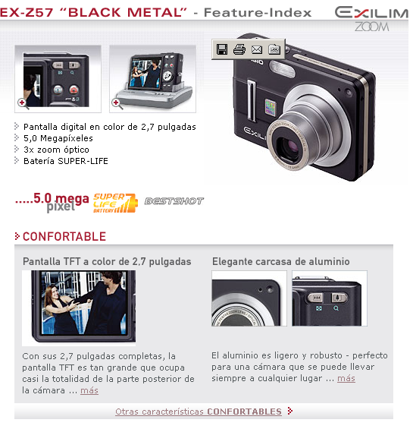



Communication Examples
La chispa de la vida

Slide 16
Basic tools of the communication mix
  Advertisement: Any non-personal communicationpaid by a company to present and promote ideas, goods or services
  Sales promotion: Short-term incentives to encourage buying a product or service.
  Public relations: Set of programmes to improve, maintain and protect the image of a company or product.
  Personal sale: Verbal communication with a potential customer.
  Direct Marketing: Direct promotion instruments

Slide 17
Advertising. The ultimate communication media
Advertising goals are:
To inform:
About a new product
Suggest new uses
Explain how it works
About a price change
To persuade:
Build brand preference.
Encourage switching to our brand
Change the product perception.
Incite buying.
To remind:
Maintaining notoriety level.
The benefits.
Where and when you can buy it

Slide 18
Considerations regarding Advertising development
This is possibly one of the most eye-catching and complex sections of the marketing mix.
However, the marketing tasks in this section are basically analytical and methodical:
  Evaluation of previous campaigns
  Evaluation of beliefs, relevant benefits and uses of the category
  Measuring the perceived image
  Supports selection
  Controlling the execution of the agency

Slide 19
Sales promotion: Main Goals
Concerning sales agents: Increase sales efficacy; Develop sales of a given product; Increase sales with certain customers.
Concerning intermediaries: Increase preference for the brands of our company; Improve stock rotation; Extend the range of distributed products.
Concerning advisors and consultants: Get to know the different uses and features of the products; Create a brand image.
Concerning consumers: Gain new consumers; Generate proofs; Encourage fidelity; Increase average purchase amount,...

Slide 20
Public relations
Set of communication activities performed by the company to create a favourable attitude towards itself, as well as to maintain a feeling of trust.
Its attractiveness is based on three distinctive characteristics: high credibility, penetration (they can reach audience who refuses advertisement), and the high potential to highlight positively the image of the company.
Its main tools are: press, conferences, seminars, annual reports, sponsorships, publications, media relations,...

Slide 21
Direct marketing
Nowadays is called relationship marketing, and it allows us to perform a direct approach to the customer we are interested in without wasting any money with people which we are not interested in.
The brand establishes a personal relationship with its current and potential customer.

